Slide 1


SESSION 1
Let’s Explore

Slide 2
Guiding Questions
How can you load cargo and transport it to different areas?
How do packages get delivered to your front door?
Outcomes
The team will build the truck and create new truck designs.
The team will use discovery to explore the CARGO CONNECTSM theme and how cargo is transported to different destinations.
What routes do cargo trucks use for transportation?
Where do you see trucks doing deliveries in your town?
Notes:
Each session has Guiding Questions that can be shared to frame the session.
Session Tips
The team will need Book 1 and Bag 1 located in the Explore set.
Most of the tasks in each session should be done together by the team.
Writing and drawing space is provided in each session for each child to capture their thoughts and ideas
Give the team the LEGO® prototyping pieces (Bag 4) to create their designs. Do NOT open Bags 2 or 3.
Place the mat on top of a table or the floor for the team to interact with the mat.
Max the dog will give session reflection questions for the team.
​

Slide 3


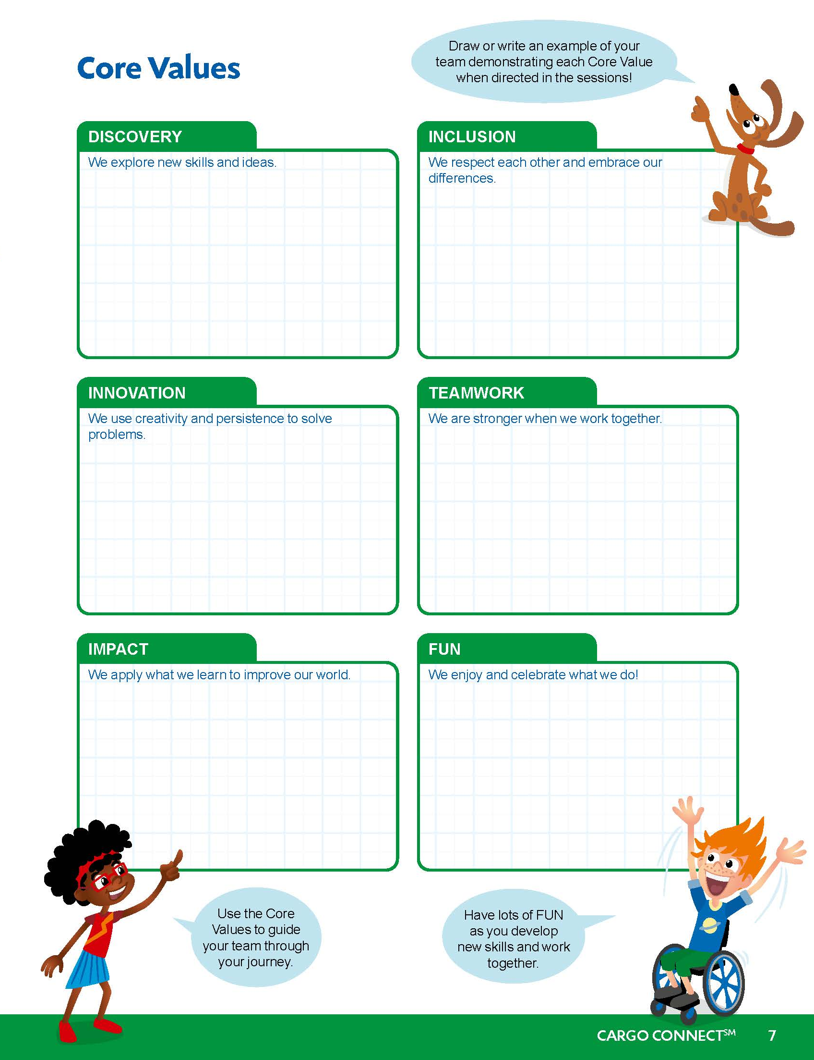
Introduction – Let’s Discover
Examples of Discovery
Ask the students to provide examples of Discovery and record them here
Example of Discovery
Example of Discovery
We explored new skills and ideas.
Extension
Notes:
Introduction
Let’s Discover
(10 minutes)
• Read the definition for discovery to the team. (see page 5)
• Talk about what discovery is. Have the team provide examples of this Core Value.
• Extension: Have everyone draw a picture of an example of discovery on the Core Values page in their Engineering Notebook.

Slide 4

Visit the
FIRST® LEGO ® League
YouTube Channel
to watch the
CARGO CONNECTSM Season Launch Video
Notes:
If you have already watched the season launch video in the introductory slides, you may choose to skip it here.

Slide 5


Task 1
How is cargo packed and loaded onto vehicles?
What products need to be transported to and from your community?
Notes:
Tasks (20 minutes)
Talk about Ruby and Jacob’s questions.
Use the space below to capture your inventive ideas!
Follow the building instructions in Book 1 to make the truck.
Look at the mat and discover how the truck works!

Slide 6

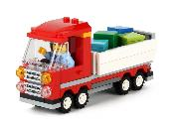
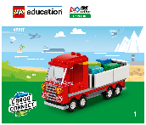
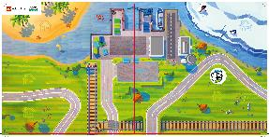
Task 1
You need…
Use the space in your Engineering Notebook to capture your inventive ideas!
Follow the building instructions in Book 1 to make the truck.
Look at the mat and discover how the truck works!
Notes:
Tasks (20 minutes)
Talk about Ruby and Jacob’s questions.
Use the space below to capture your inventive ideas!
Follow the building instructions in Book 1 to make the truck.
Look at the mat and discover how the truck works!

Slide 7

Capture Your Inventive Ideas!
Notes:
Tasks (20 minutes)
Talk about Ruby and Jacob’s questions.
Use the space below to capture your inventive ideas!
Follow the building instructions in Book 1 to make the truck.
Look at the mat and discover how the truck works!

Slide 8

Task 2
Circle the routes the truck can take on the mat image in your Engineering Notebook.
Notes:
Tasks (20 minutes)
Circle the routes the truck can take on the mat image.
Draw your design of a truck that transports cargo.
Label what products are in the cargo the truck transports.
Share your creation with your team!
Work as a team to build your amazing truck designs using the LEGO® prototyping pieces (Bag 4).
Place your built trucks on the mat and show how they work.

Slide 9
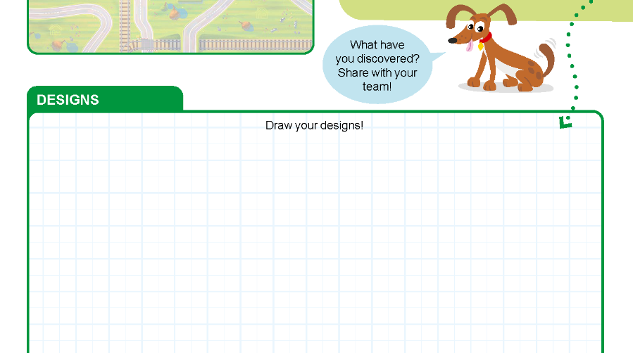
Task 2
Draw your design of a truck that transports cargo.
Label what products are in the cargo the truck transports.
Share your creation with your team!
Notes:
Tasks (20 minutes)
Circle the routes the truck can take on the mat image.
Draw your design of a truck that transports cargo.
Label what products are in the cargo the truck transports.
Share your creation with your team!
Work as a team to build your amazing truck designs using the LEGO® prototyping pieces (Bag 4).
Place your built trucks on the mat and show how they work.

Slide 10
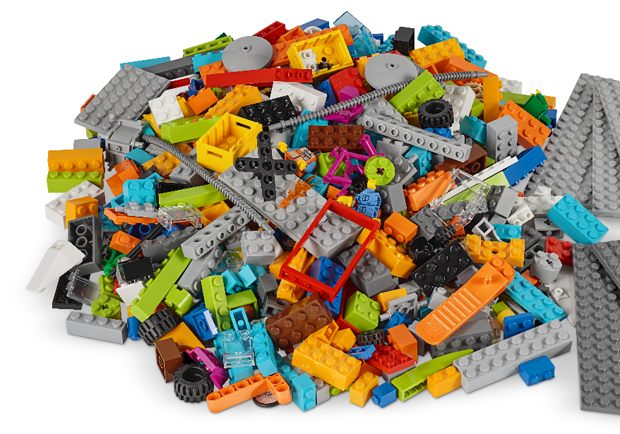
Task 2
Work as a team to build your amazing truck designs using the LEGO® prototyping pieces (Bag 4).
Notes:
Tasks (20 minutes)
Circle the routes the truck can take on the mat image.
Draw your design of a truck that transports cargo.
Label what products are in the cargo the truck transports.
Share your creation with your team!
Work as a team to build your amazing truck designs using the LEGO® prototyping pieces (Bag 4).
Place your built trucks on the mat and show how they work.

Slide 11
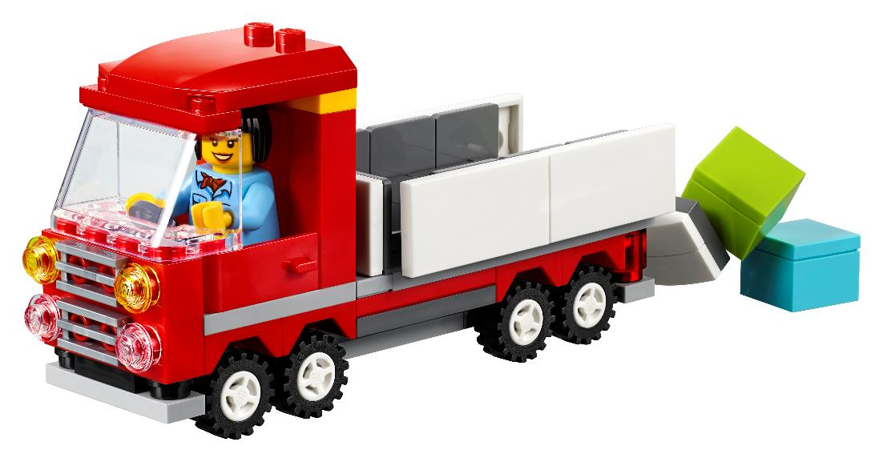
Task 2
Place your built trucks on the mat and show how they work.
Notes:
Tasks (20 minutes)
Circle the routes the truck can take on the mat image.
Draw your design of a truck that transports cargo.
Label what products are in the cargo the truck transports.
Share your creation with your team!
Work as a team to build your amazing truck designs using the LEGO® prototyping pieces (Bag 4).
Place your built trucks on the mat and show how they work.

Slide 12

Share
Share what you did in the session.
Explain how cargo is transported to and from your community.
Describe your truck designs.
Demonstrate how your solutions work on the mat.
What have you discovered? Share with your team!
Notes:
Share (10 minutes)
Have the team:
• Share what they did in the session.
• Explain how cargo is transported to and from their community.
• Describe their truck designs.
• Demonstrate how their solutions work on the mat.

Slide 13
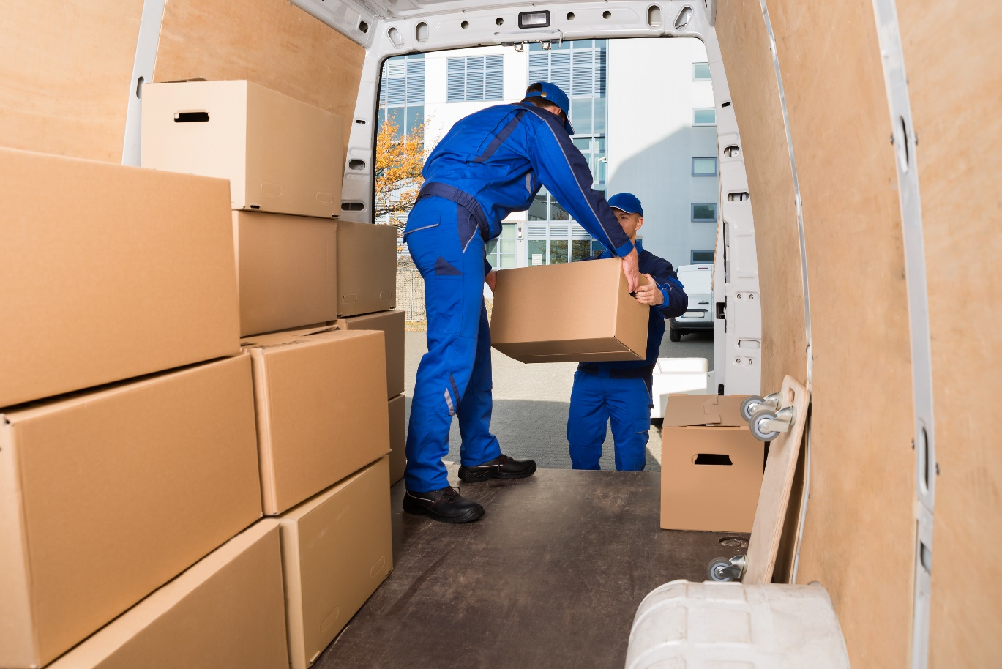
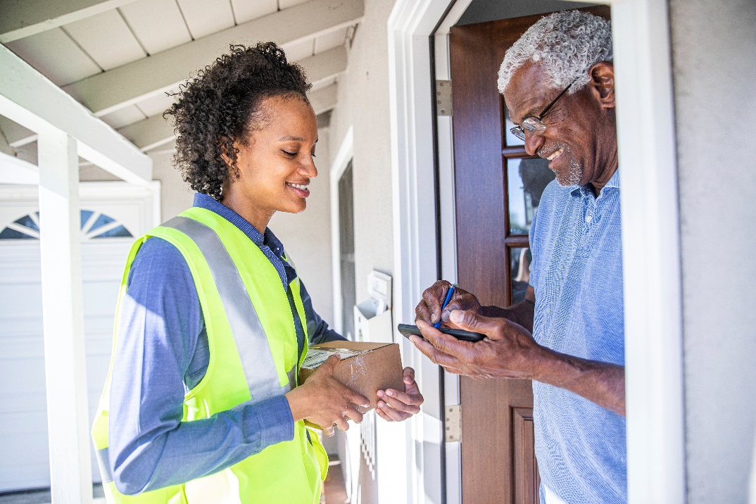
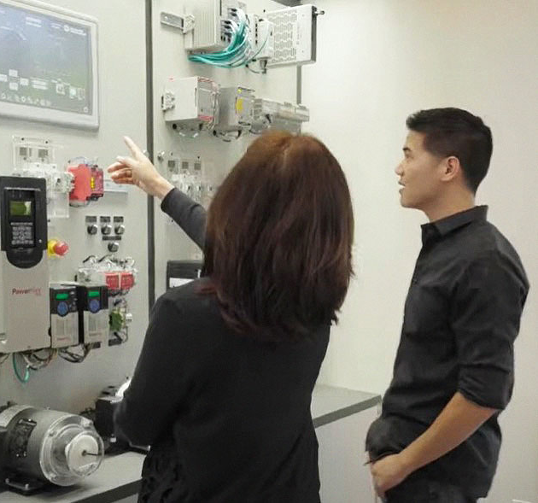
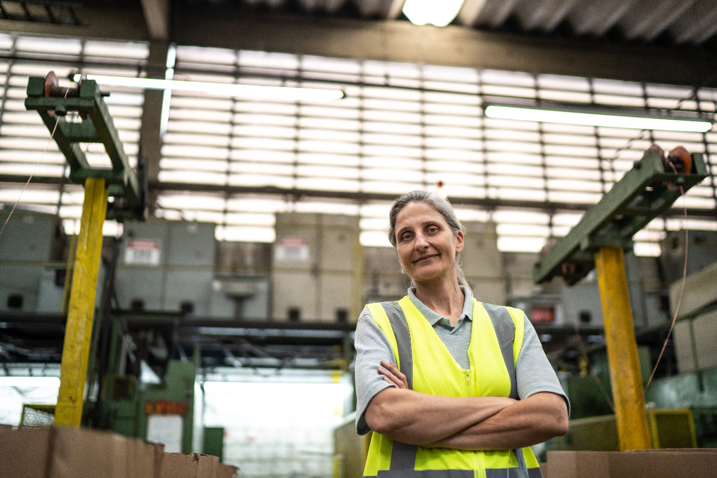
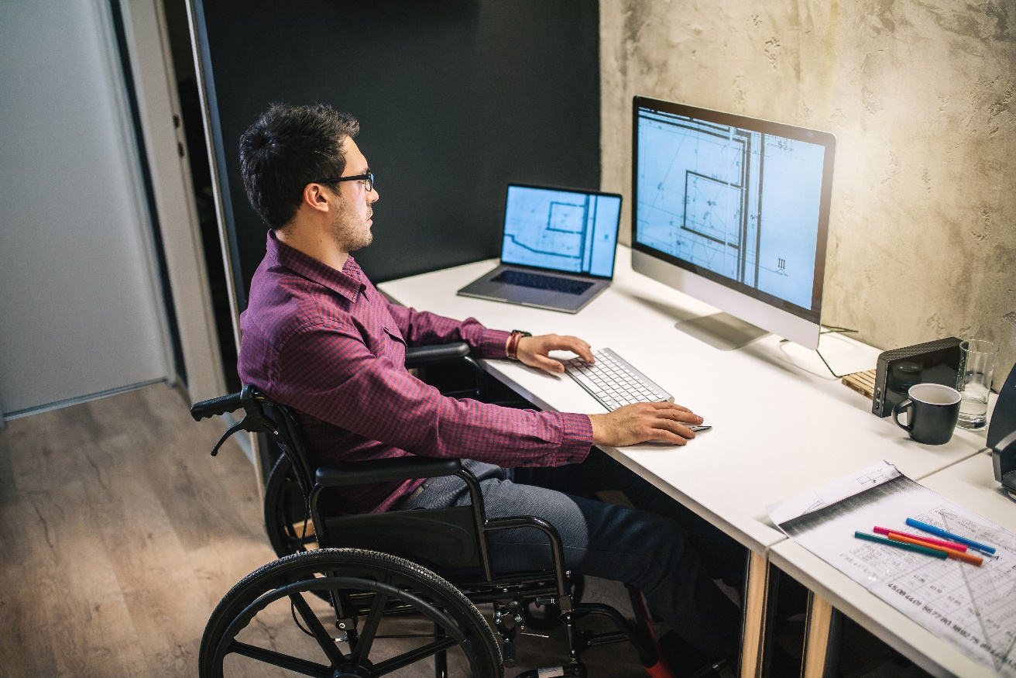
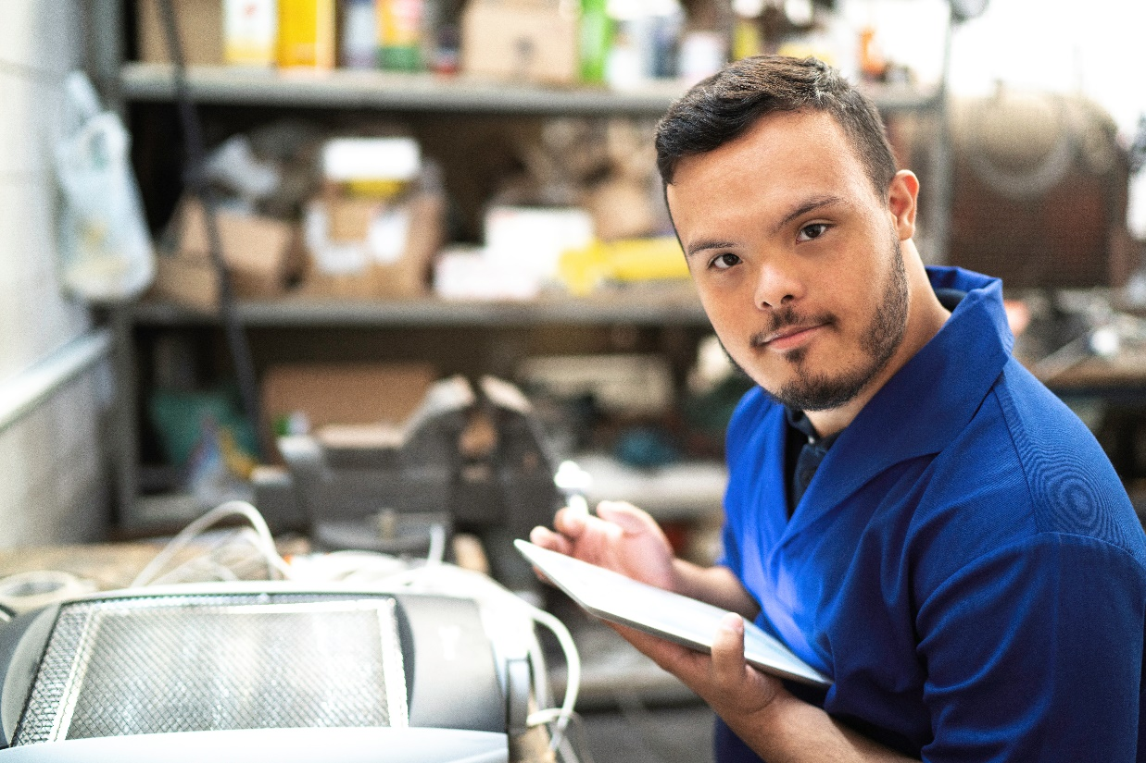
Career Connections
Can you think of some jobs related to cargo transportation?
We will explore career connections related to transportation during the FIRST® LEGO® League Explore sessions.
Freight Driver
Notes:
Have the children share and explain what they built and how the pieces they identified relate to transportation. All the children’s builds will be correct and there is no one right answer to these sessions.

Slide 14

Clean Up
Notes:
You may wish to play a video or song during clean up time Link on GoNoodle: https://family.gonoodle.com/activities/clean-up. Link on YouTube Kids: https://www.youtubekids.com/watch?v=ZJFk87ZsHn0 . Link on Youtube: https://youtu.be/ZJFk87ZsHn0
Cleanup Pointers
• The truck should stay assembled, but everything else should be taken apart.
• Place the prototyping pieces back in the Explore box or in a container labeled “Prototyping Pieces.”

Slide 15
FIRST® and the FIRST® logo are registered trademarks of For Inspiration and Recognition of Science and Technology (FIRST). LEGO® is a registered trademark of the LEGO Group. FIRST® LEGO® League and CARGO CONNECTSM are jointly held trademarks of FIRST and the LEGO Group. All other trademarks are the property of their respective owners. ©2021 FIRST and the LEGO Group. All rights reserved.

